Slide 1
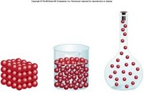
Density
Volume and mass

Slide 2
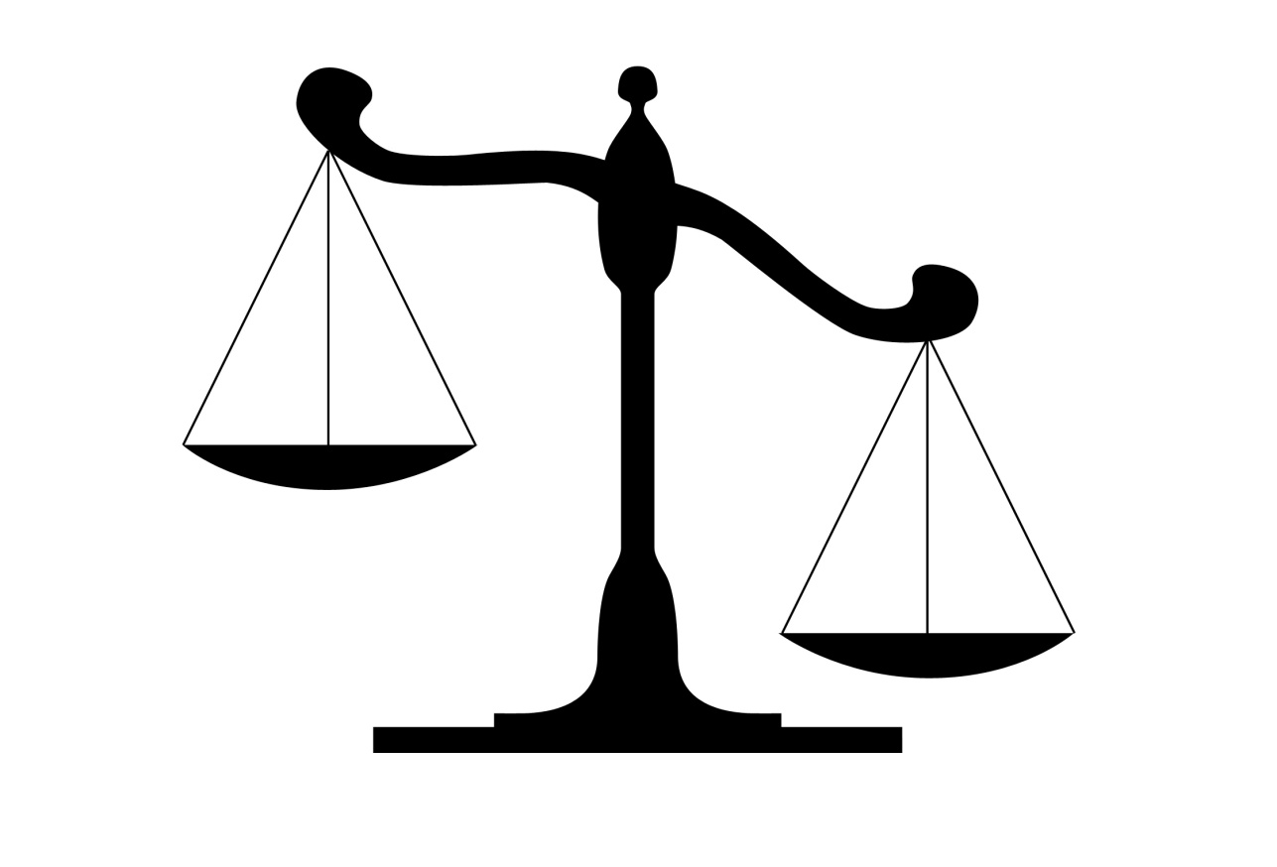
Mass
Measurement of the amount of matter
(or stuff) in an object
  Measured in grams (g)

Slide 3
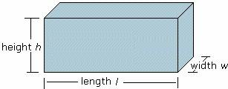
Volume
Measurement of the amount of space an object takes up
  Measured in milliliters (ml) or cm³

Slide 4
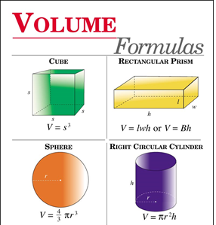
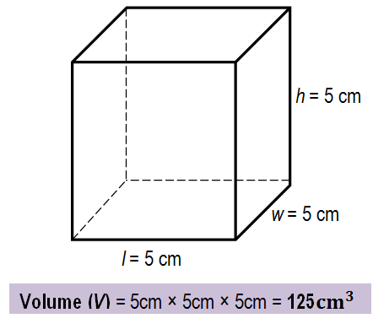
Finding volume
Calculate using formulas
Place in water and measure the displaced water

Slide 5
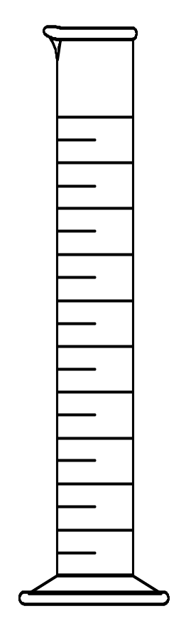
Volume Displacement
A solid displaces a matching volume of water when placed in water.
33 mL
25 mL

Slide 6
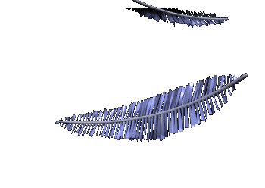
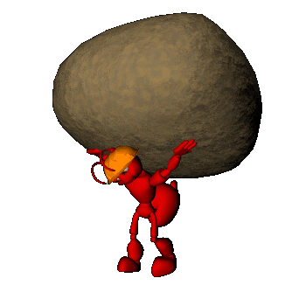
Which do you think would have the greater volume? The greater mass?
1 kg of feathers
1 kg of rocks
They have the same mass 1kg
But the feathers would take up more space

Slide 7
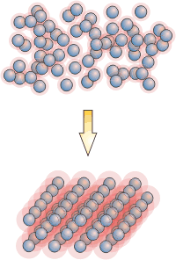
How are mass and volume related?

Slide 8
Density
mass and volume relationship

Slide 9
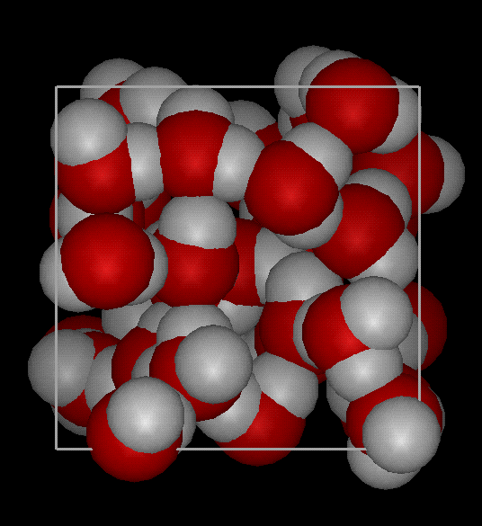
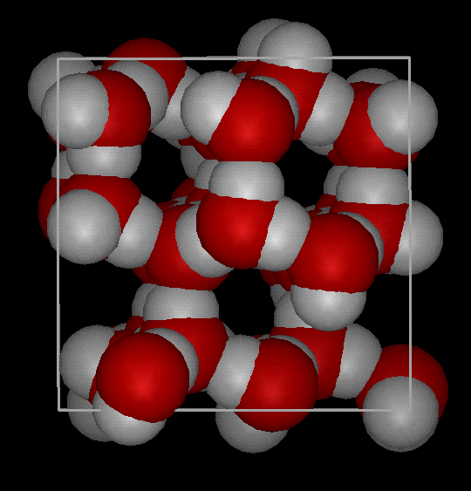
Density
Density is the amount of matter within a volume.
It is a measure of how tightly packed the atoms are in an object.
Notes:
Density is the amount of matter within a certain volume.

Slide 10
Which one is more dense?

Slide 11
Which one is more dense?
Now which one is more dense?
This one because there is less space

Slide 12
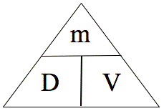
Calculating density
Formula:
M = mass V= volume D = density
Density = Mass / Volume
Mass= density x volume
Volume = mass / density

Slide 13
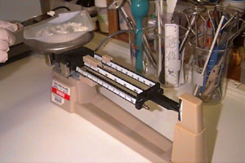
To find the density
1- Find the mass of the object
1- Find the mass of the object
2- Find the volume of the object
3- Divide
Density = Mass
Volume
ALWAYS REMEMBER UNITS!

Slide 14

Example
Ex. If the mass of a box is 21g and it takes up 7 cm³ of space find the density.
Use the GRASS method.
G→ Given
R→ Required To Find
A→ Application
S→ Solution
S→ Statement

Slide 15
Ex. If the mass of a box is 21g and it takes up 7 cm³ of space find the density.
G→ m=21g
v= 7cm³
R→ d
A→ d=m/v
d=21g/7cm³
S→ d=3g/cm³
S→ the density of the box is 3g/cm³

Slide 16
Example 2
Ms K has a green pen. The pen has a mass of 8g and a volume of 2cm³. What is the density of the pen?
G→ m=8g
        V=2cm³
R→ d
A→ d=m/v
        d=8g/2cm³
S→ d=4g/cm³
S→ The density of the pen is 4g/cm³

Slide 17
Let’s try!
Work on these problems with your neighbour
1 Troy has a paper clip. It has a mass of 9g and a volume of 3cm³. What is its density?
2. Troy also has an eraser. It has a mass of 3g, and a volume of 1cm³. What is its density?
3. Kassia has a rock. The rock has a mass of 6g and a volume of 3cm³. What is the density of the rock?

Slide 18
Learning Check
What is the density of 48 g of a metal if the metal raises the level of water in a graduated cylinder from 25 mL to 33 mL?
1) 0.2 g/ cm³ 2) 6 g/m³ 3) 252 g/cm³
33 mL
25 mL
G → m=48g
v=8ml
R→ d=?
A→ d=m/v
=48g/8ml
S→ =6g/ml
S→ the density is 6g/ml

Slide 19
Density fun: liquid layers
http://www.youtube.com/watch?v=-CDkJuo_LYs
Liquids with different densities form layers
The liquid with the highest density will be on the bottom.
The liquid with the lowest density will be on the top.

Slide 20
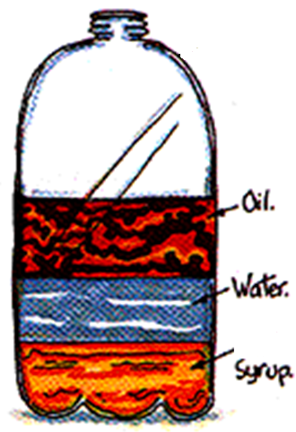
Liquid Layers
Lowest density
Which liquid has the highest density?
Which liquid has the lowest density?
Which liquid has the middle density?
Highest density

Slide 21
Review
What is the formula for density?
What happens if you pour together liquids that have different densities?
Will the liquid on the top have the highest or lowest density?

Slide 22
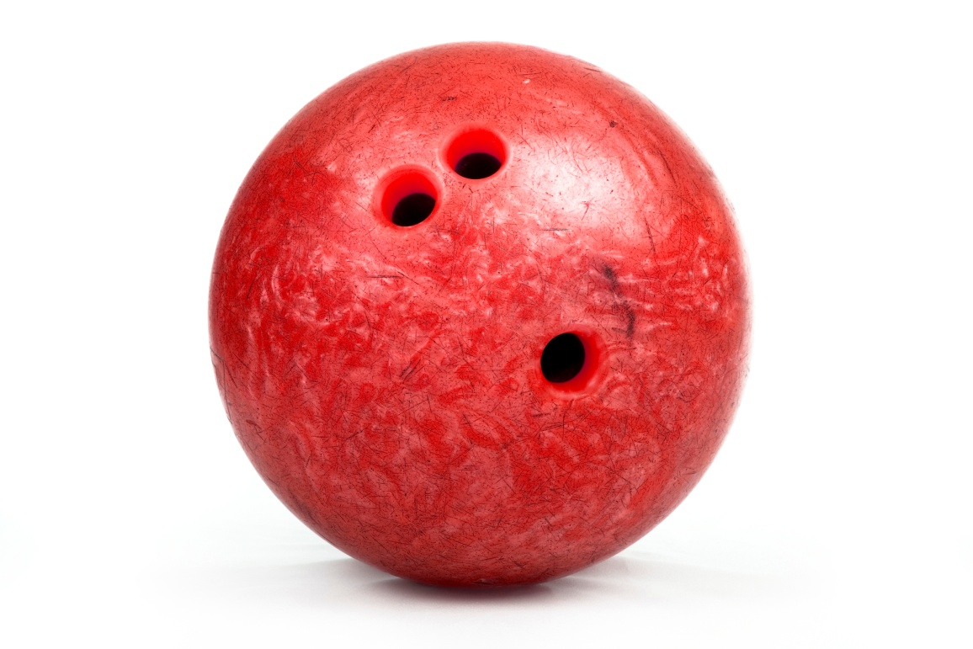
What would happen????
If you put a bowling ball in water?
http://www.youtube.com/watch?v=Lwc6QklQGFw
Notes:
Sinking vial - make it float

Slide 23
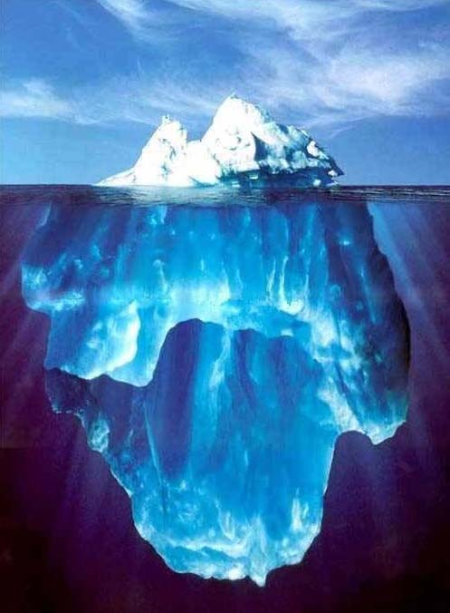
SOLIDS
Why does ice float in water?
  Because Ice is less dense than water
Notes:
Beans/ping pong ball; Big jug of water in a pool

Slide 24
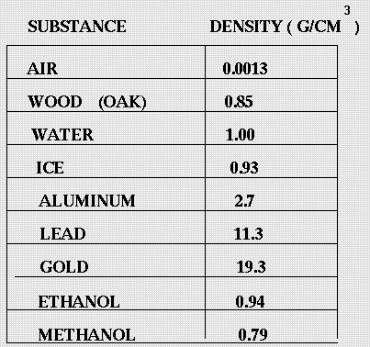
SINK or FLOAT In Water
Lower densities will float, higher will sink
Float
Float
Float
Sink
Sink
Sink
(alcohol)
Float
(fuel)
Float

Slide 25
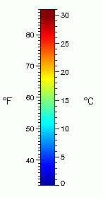
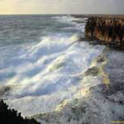
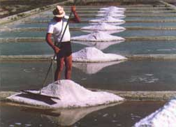
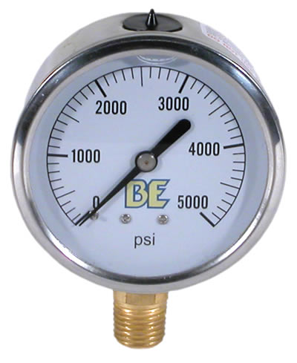
Factors affecting Density
Temperature
Pressure
Dissolved solids – in liquids
    Ex salt in water
Notes:
Add several drops of red food color to each of two 250-mL Erlenmeyer flasks; fill them with warm tap water. (If tap water is not warm, heat some tap water on a hot plate to 40-45 °C.)
Add several drops of blue food coloring to each of the other two 250-mL Erlenmeyer flasks; fill them with cool tap water.
Predict the outcome when one flask is inverted over the other.
Place a paper card on top of the vessel filled with warm water. Invert the flask making sure to hold the card in place. Stack it on top of one of the cool water flasks. Remove the card. Remain prepared to catch the flasks.
** Visual here.
Place a paper card on top of the flask filled with cool water. Invert the flask making sure to hold the card in place. Stack it on top of the other warm water flask. Remove the card.
** Visual here.
Wide mouth containers may also be used.

